Slide 1
Prediction of Preoperative Risk
CDAC-ACTS-DBDA-September-23
Under the Guidance of:
Mr. Saurabh Panwar
Pesented by:
Amey Pote (230940125002)
Anjali Kohar (230940125005)
Bharti Ghildiyal (230940125008)
Khushi Songirkar (230940125026)
Siddhesh Thakare (230940125048)

Slide 2
Introduction
Insights into Complications
Assessing potential complications vital to healthcare decision-making.
Enhancing Patient Safety
Accurate risk assessment optimizes postoperative care.
Impact of Machine Learning
Advanced techniques can revolutionize preoperative risk analysis.

Slide 3
Enhance Prediction Accuracy Improving the precision of risk prediction for better outcomes. Optimize Decision Making Making informed decisions based on accurate risk assessment. Contribute to Personalized Healthcare Developing tailored interventions for individualized care.
Objective

Slide 4

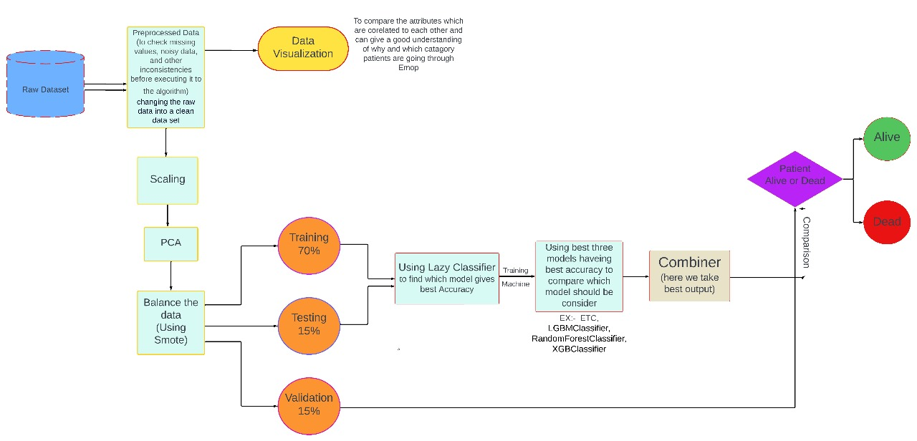
Workflow Chart

Slide 5
Data Source
Data Description
Kaggle - https://www.kaggle.com/datasets/kamyababedi/vitaldb
VitalDB (Vital Signs DataBase) is an open dataset created specifically to facilitate machine learning studies related to monitoring vital signs in surgical patients. There are total 5 csv files.
clinical_data.csv , clinical_parameters.csv , lab_data.csv , lab_parameters.csv track_names.csv
This dataset contains high-resolution multi-parameter data from 6,388 cases, including 486,451 waveform and numeric data tracks of 196 intraoperative monitoring parameters, 73 perioperative clinical parameters, and 34 time-series laboratory result parameters.
We have w orked on clinincal _data.csv as our objective is to predict preoperative risk. Our dataset includes a crucial column named “death_inhosp," serving as the target variable for our analysis.

Slide 6
Features Description
case_id: Unique identifier.
age: Patient's age (years).
bmi: Body Mass Index.
asa: Anesthesia classification.
sex: Patient's gender (0=female, 1=male).
department: Surgical department code.
optype: Operation type code.
ane_type: Anesthesia type code.
and some lab results (preop_hb, preop_dm, preop_pt etc. )

Slide 7

Lab Parameters
Parameters | Description | Unit | Reference Value
hb | Hemoglobin | g/dL | 13~17
plt | Platelet count | ×1000/mcL | 130~400
gluc | Glucose | mg/dL | 70~110
alb | Albumin | g/dL | 3.3~5.2
ast | Asparate transferase | IU/L | 1~40
alt | Alanine transferase | IU/L | 1~40
bun | Blood urea nitrogen | mg/dL | 10~26
cr | Creatinine | mg/dL | 0.70~1.40
na | Sodium | mmol/L | 135~145
k | Pottasium | mmol/L | 3.5~5.5

Slide 8
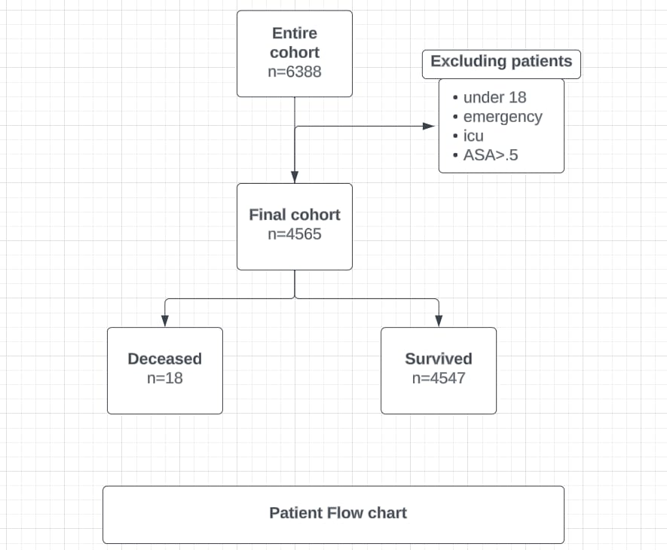
Data Preparation

Slide 9

Data Cleaning
Dealing with missing data
Removing identity columns
Null value imputation
Categorical data interpretation

Slide 10
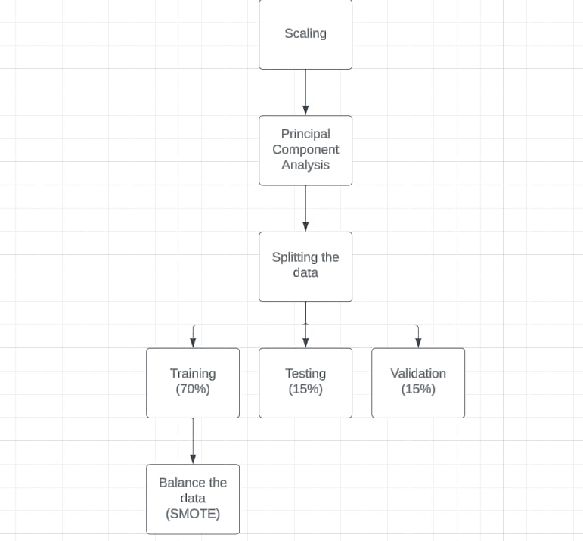
Data Transformation
Scaling the data
Principal Component Analysis
Data Balancing

Slide 11
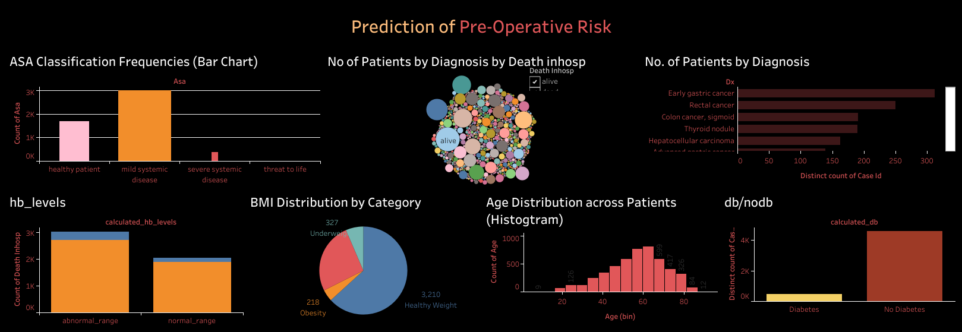
Exploratory Data Analysis

Slide 12
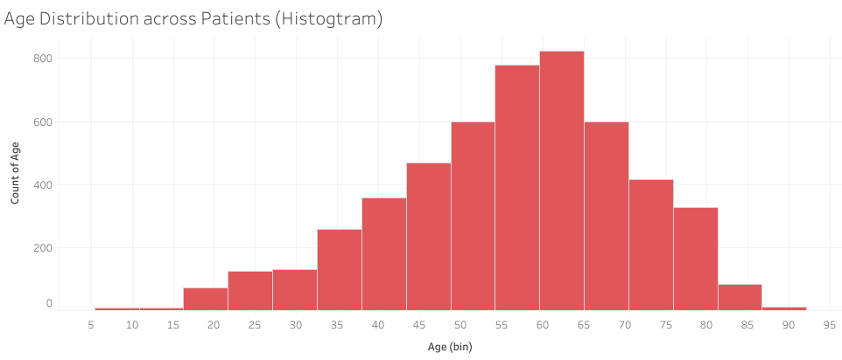
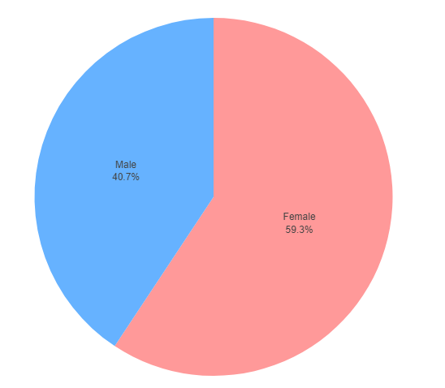
Age Distribution
The dataset exhibits a right-skewed age distribution with a mean of 56.33 years and a concentration between 48-65 years. The broad range spans from 18 to 89 years, highlighting a predominance of middle-aged to older individuals.
Gender Distribution

Slide 13
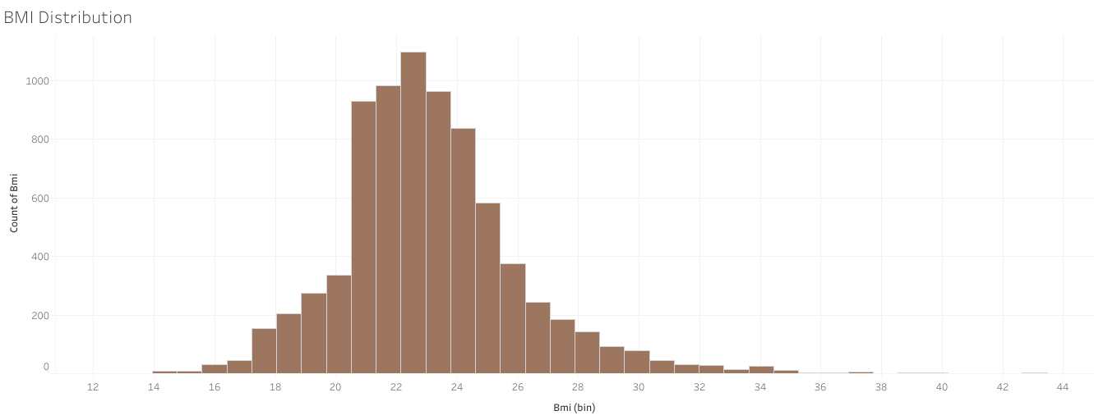
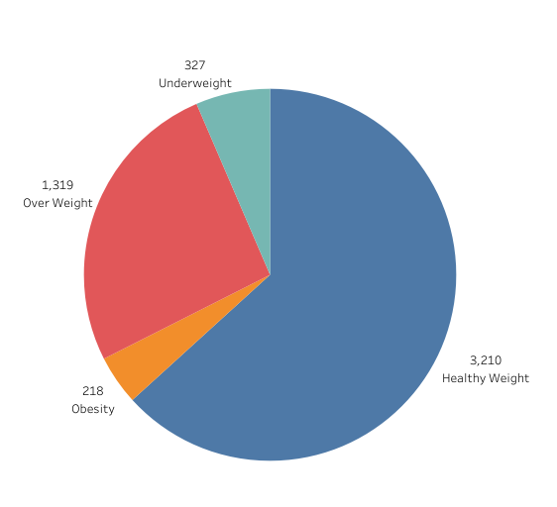
BMI Distribution
Mean(23.08). The interquartile range (21.3 to 24.5) indicates a significant proportion falling within this range, with some variability in lower and higher BMIs.

Slide 14
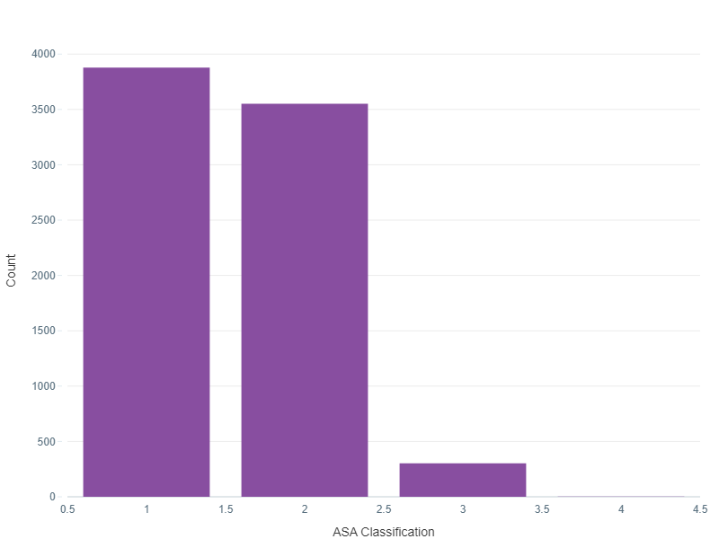
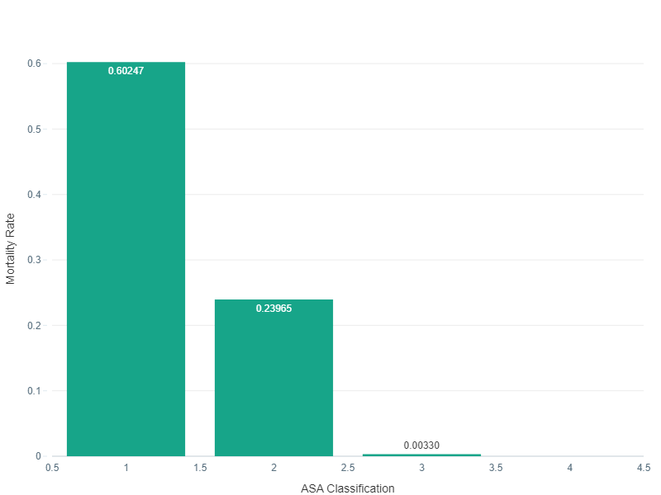
ASA Classification
Mortality Across ASA Classifications
-ASA Class 1: Count-3879
-ASA Class 2: Count- 3551
-ASAClass 3: Count-303
-ASA Class 4:Count-3

Slide 15
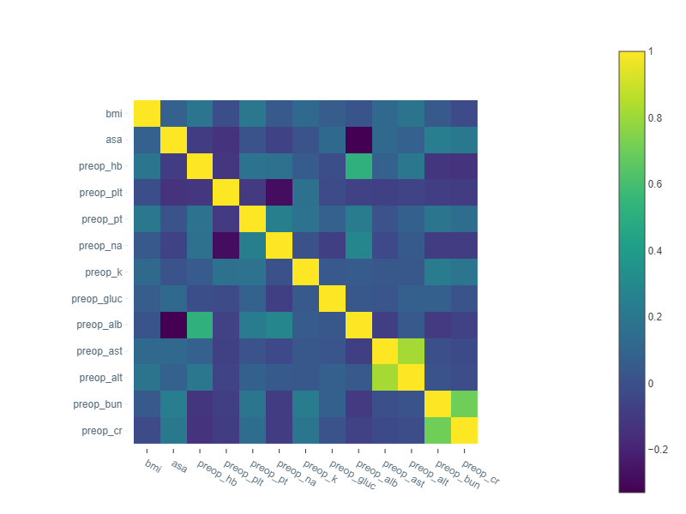
Correlation Matrix
Represents relationships between specific numerical features in the dataset.

Slide 16
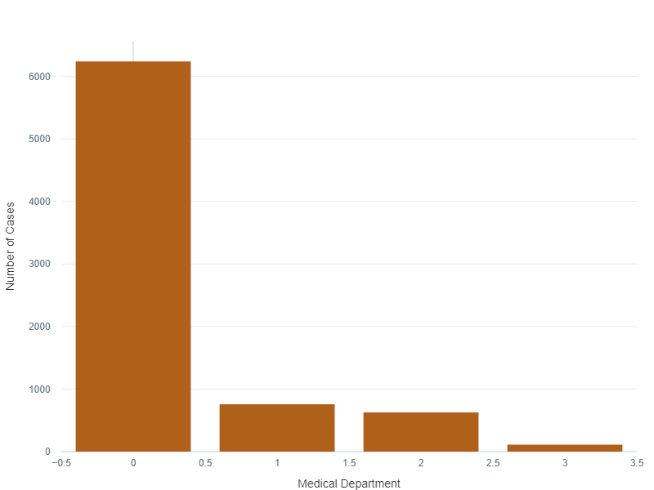
Number of cases by Medical Department
0 - General Surgery
1 - Urology
2 - Thoracic Surgery
3 - Gynecology

Slide 17
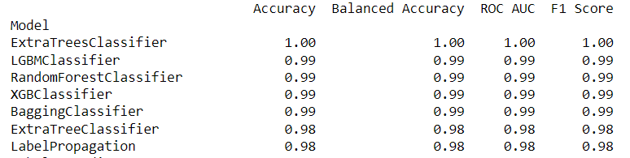
Machine Learning Models
Lazy Predict
Lazy Predict is a Python library that automates the model selection and training process in machine learning.
It provides a quick way to evaluate and compare multiple machine learning models without the need for extensive manual tuning.
The library takes a "lazy" approach by using default hyperparameters for each algorithm and provides a baseline performance comparison.
Lazy Predict will automatically evaluate a variety of classifiers on your dataset and provide a summary of their performance metrics.

Slide 18
Extra Tree Classifier
Ensemble Approach: Extra Trees Classifier employs an ensemble of randomized decision trees, enhancing robustness through feature and data subset randomness.
Randomized Thresholds: The classifier introduces randomness by using random thresholds for features, preventing overfitting and increasing ensemble diversity.
Computational Efficiency: Extra Trees is highly efficient, suitable for large datasets and high-dimensional feature spaces, thanks to its randomization and parallelization capabilities.

Slide 19
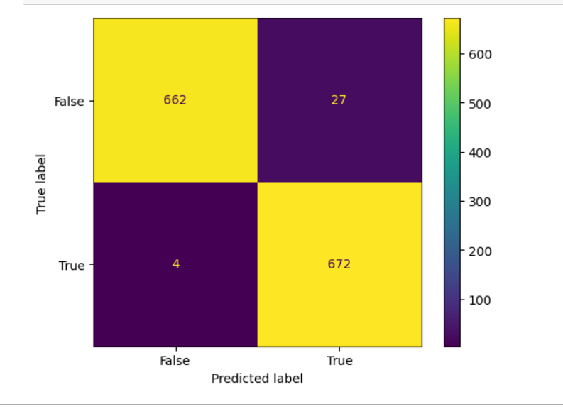

Slide 20
LGBM Classifier
Efficient Training: LGBMClassifier, from LightGBM, is fast and efficient, making it ideal for handling large datasets swiftly.
Categorical Features Made Easy: It deals with categorical features smoothly, saving you from complex data preparations. This is especially useful when your data mixes numerical and categorical features.
Accurate and Light on Memory: LightGBM's smart tree growth ensures accuracy without hogging memory, making it perfect for effective learning, even in situations where memory is limited.

Slide 21
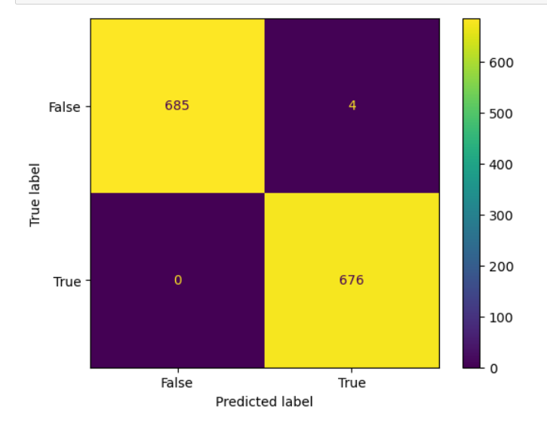

Slide 22
RandomForest Classifier
Ensemble of Decision Trees: Random Forest Classifier is an ensemble learning method that builds multiple decision trees during training and combines their predictions for robust and accurate results.
Feature Importance: It provides a feature importance ranking, allowing users to understand which features contribute most to the model's predictive power, aiding in feature selection and interpretation.
Reduced Overfitting: The ensemble nature and randomness in building trees help reduce overfitting, making Random Forest a powerful and versatile algorithm for various machine learning tasks.

Slide 23
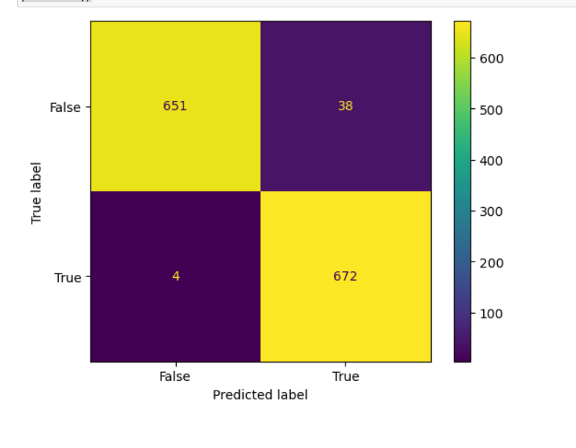

Slide 24
ML_Models
ML_Model | Accuracy | ROC_AUC Score
Extra Tree Classifier | 0.9772 | 0.98
LGBM Classifier | 0.9971 | 1.0
Random Forest Classifier | 0.9692 | 1.0

Slide 25
Conclusion
the preoperative prediction of ML models highlights the importance of sharing accurate information to improve surgical planning and patient safety. Continued research is essential for refining predictive algorithms and enhancing surgical outcomes. It's crucial to prioritize data transparency and avoid spreading unverified information to maintain trust in these predictive models.

Slide 26
Future Scope
Personalized Treatment Planning
Intraoperative: Real-time decision support for surgeons
Postoperative: Predicting patient recovery and long-term outcomes.

Slide 27
THANKS !

